Slide 1

Physical Database Design & Tuning
Trường ĐH Bách Khoa Tp.HCM
Khoa Khoa Học và Kỹ Thuật Máy Tính
GV: PGS.TS ĐẶNG TRẦN KHÁNH
GROUP 3
Chu Xuân Tình - 1870583
Huỳnh Nguyễn Viết Thành - 1870578

Slide 2
Outline
introduction & Basic index methods
1.1. B+ tree
1.2. Compose index
1.3. Bitmap index
1.4. Summary
2. Selecting Materialized Views
2.1. Simple View Materialization
2.2. Exploiting Commonality
2.3. Exploiting grouping and Generalization
2.4. Resource Considerations
2.5. Tips and Insights for Database Professionals

Slide 3
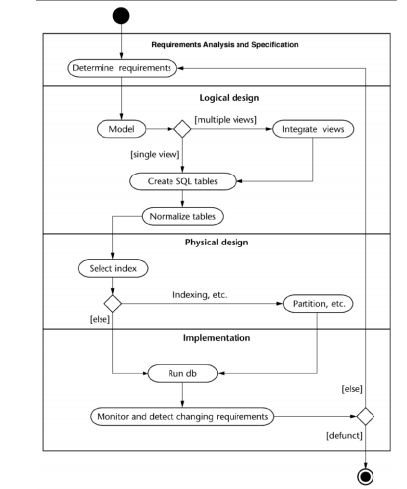
Relational DB design

Slide 4
Relational DB design
Database design phases: (a) Requirement Analysis, (b) Conceptual design (c) Logical design (d) Physical design
Concept:
It is the process of transforming a logical data model into a physical model of a database
It focuses on the methods of storing and accessing those tables on disk that enable the database to operate with high efficiency.

Slide 5
Physical Database Design
Physical Design Goal
Physical Design Goal: definition of appropriate storage structures for a specific DBMS, to ensure the application performance desired
Good design and tuning requires understanding the database workload.
A workload description contains • the most important queries and their frequency • the most important updates and their frequency • the desired performance goal for each query or update
Notes:
WORKLOAD:
các truy vấn quan trọng nhất và tần suất của chúng
các cập nhật quan trọng nhất và tần suất của chúng
mục tiêu hiệu suất mong muốn cho mỗi truy vấn hoặc cập nhật

Slide 6
Physical Database Design
Definition (Workload Description)
For each query: • Which relations are accessed? • Which attributes are retrieved? • Which attributes occur in selection/join conditions? How selective is each condition?
For each update: • Type of update and relations/attributes affected. • Which attributes occur in selection/join conditions? How selective is each condition?

Slide 7
Physical Database Design
The physical database design step involves the selection of
Indexes: An index is a data organization set up to speed up the retrieval (query) of data from tables.
Partitioning:
method for reducing the workload on any hardware component
balance the workload across the system and preventing bottlenecks.
Clustering:
Technique by which data can be clustered by dimensions (such as location, timeframe or product type
Offer potentially huge performance improvement for query processing by reducing the I/O processing
Selective materialization of data
Notes:
Phân cụm:
Cung cấp cải tiến hiệu suất rất lớn để xử lý truy vấn bằng cách giảm xử lý I / O

Slide 8
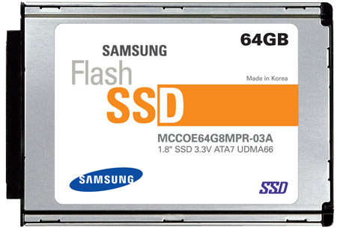
Physical Database Design
A storage strategy?
Access Methods
Storage structures for relations: – heap (small data set, scan operations, use of indexes): Set of records, partitioned into blocks - Unsorted – sequential (sorted static data) – hash (key equality search), usually static – tree (index sequential) (key equality and range search )
Choice of secondary index, considering that – they are extremely useful – slow down the updated of the index keys – require memory
Sorted File
Hash Index
Recovery Manager
Concurrency Control Manager
Heap File
B+-tree Index
Buffer Manager
I/O Manager
IO Accesses

Slide 9
Physical Database Design
Operations on an Index
Indexing is a way to optimize the performance of a database by minimizing the number of disk accesses required when a query is processed.
Search: Quickly find all records which meet some condition on the search key attributes
Insert / Delete entries
Indexing is one the most important features provided by a database for performance
Notes:
Tìm kiếm: Nhanh chóng tìm thấy tất cả các bản ghi đáp ứng một số điều kiện trên các thuộc tính khóa tìm kiếm Chèn / xóa các mục Lập chỉ mục là một trong những tính năng quan trọng nhất được cung cấp bởi cơ sở dữ liệu để thực hiện
Indexes are created using a few database columns.
The first column is the Search key that contains a copy of the primary key or candidate key of the table. These values are stored in sorted order so that the corresponding data can be accessed quickly. Note: The data may or may not be stored in sorted order.
The second column is the Data Reference or Pointer which contains a set of pointers holding the address of the disk block where that particular key value can be found.

Slide 10
Physical Database Design
Index Classification
Clustered/unclustered
– Clustered = records close in index are close in data
– Unclustered = records close in index may be far in data
Primary/secondary
- Primary = is over attributes that include the primary key Secondary = otherwise
Multilevel Indexing: B+ tree

Slide 11
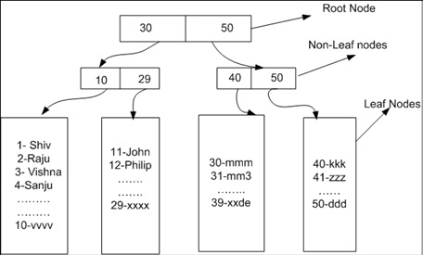
Physical Database Design
Clustered
Cluster index is a type of index which sorts the data rows in the table on their key values.
A clustered index defines the order in which data is stored in the table
Only one clustered index per table.
Notes:
In the Database, there is only one clustered index per table.

Slide 12
Physical Database Design
Clustered
Advantages of Clustered Index
Clustered indexes are an ideal option for range or group by with max, min, count type queries
In this type of index, a search can go straight to a specific point in data so that you can keep reading sequentially from there.
Clustered index method uses location mechanism to locate index entry at the start of a range.
It is an effective method for range searches when a range of search key values is requested.
Helps you to minimize page transfers and maximize the cache hits.
Notes:
Ưu điểm của chỉ số cụm
Những ưu / lợi ích của chỉ số được nhóm là:
Các chỉ mục được nhóm là một tùy chọn lý tưởng cho phạm vi hoặc nhóm bằng các truy vấn loại tối đa, tối thiểu, đếm
Trong loại chỉ mục này, một tìm kiếm có thể đi thẳng đến một điểm cụ thể trong dữ liệu để bạn có thể tiếp tục đọc tuần tự từ đó.
Phương pháp chỉ mục cụm sử dụng cơ chế vị trí để xác định vị trí mục nhập khi bắt đầu một range.
Đây là một phương pháp hiệu quả cho các tìm kiếm phạm vi khi một phạm vi các giá trị khóa tìm kiếm được yêu cầu.
Giúp bạn giảm thiểu chuyển trang và tối đa hóa các lần truy cập bộ đệm.

Slide 13
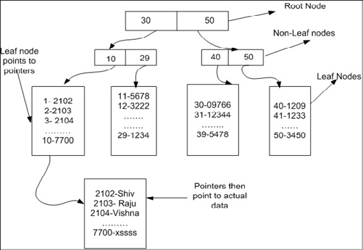
Physical Database Design
Non-clustered index
A Non-clustered index stores the data at one location and indices at another location
The index contains pointers to the location of that data
A single table can have many non-clustered indexes
A non-clustering index is defined in the non-ordering field of the table
Notes:
Một chỉ mục không phân cụm lưu trữ dữ liệu tại một vị trí và chỉ mục tại một vị trí khác. Chỉ mục chứa con trỏ đến vị trí của dữ liệu đó. Một bảng duy nhất có thể có nhiều chỉ mục không được phân cụm vì một chỉ mục trong chỉ mục không được phân cụm được lưu trữ ở những nơi khác nhau. Ví dụ: một cuốn sách có thể có nhiều hơn một chỉ mục, một ở đầu hiển thị nội dung của một đơn vị sách một cách khôn ngoan trong khi chỉ mục thứ hai hiển thị chỉ mục các thuật ngữ theo thứ tự bảng chữ cái. Một chỉ mục không phân cụm được xác định trong trường không theo thứ tự của bảng. Loại phương pháp lập chỉ mục này giúp bạn cải thiện hiệu suất của các truy vấn sử dụng các khóa không được gán làm khóa chính. Một chỉ mục không được nhóm cho phép bạn thêm một khóa duy nhất cho một bảng.

Slide 14
Physical Database Design
Non-clustered index
Advantages of Non-clustered index
A non-clustering index helps you to retrieves data quickly from the database table.
Helps you to avoid the overhead cost associated with the clustered index
A table may have multiple non-clustered indexes in RDBMS. So, it can be used to create more than one index.
Notes:
Một chỉ mục không phân cụm giúp bạn lấy dữ liệu nhanh chóng từ bảng cơ sở dữ liệu.
-tránh được chi phí trên không liên quan đến chỉ mục được nhóm
Một bảng có thể có nhiều chỉ mục không được nhóm trong RDBMS. Vì vậy, nó có thể được sử dụng để tạo nhiều hơn một chỉ mục.

Slide 15
Disadvantages of Clustered Index
Here, are cons/drawbacks of using clustered index:
Lots of inserts in non-sequential order
A clustered index creates lots of constant page splits, which includes data page as well as index pages.
Extra work for SQL for inserts, updates, and deletes.
A clustered index takes longer time to update records when the fields in the clustered index are changed.
The leaf nodes mostly contain data pages in the clustered index.
Disadvantages of Non-clustered index
Here, are cons/drawbacks of using non-clustered index:
A non-clustered index helps you to stores data in a logical order but does not allow to sort data rows physically.
Lookup process on non-clustered index becomes costly.
Every time the clustering key is updated, a corresponding update is required on the non-clustered index as it stores the clustering key.

Slide 16
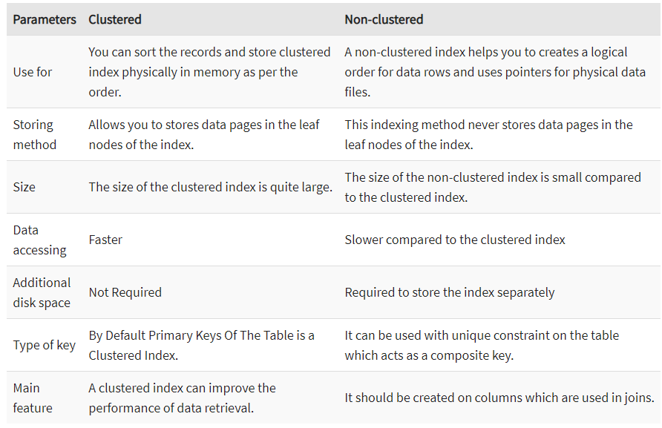
Physical Database Design
Clustered Index vs Non-Clustered Index
Notes:
There are primarily three methods of indexing:
Clustered Indexing /Primary index
Non-Clustered or Secondary Indexing
Multilevel Indexing

Slide 17
B+ Tree
B+ Tree
DBMS offer a variety of special access structures to find the requested record without reading the entire file. The most common one is the B+-tree
Search trees
B does not mean binary!
Idea in B Trees:
make 1 node = 1 physical page
Balanced, height adjusted tree (not the B either)
Idea in B+ Trees:
Make leaves into a linked list (for range queries)
Notes:
DBMS cung cấp nhiều cấu trúc truy cập đặc biệt để tìm bản ghi được yêu cầu mà không cần đọc toàn bộ tệp. Phổ biến nhất là B + -tree

Slide 18
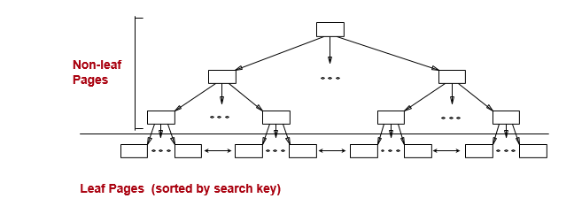
B+ Tree
B+ Tree
Leaf pages contain data entries, and are chained (prev & next)

Slide 19
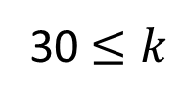
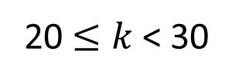
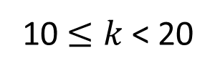

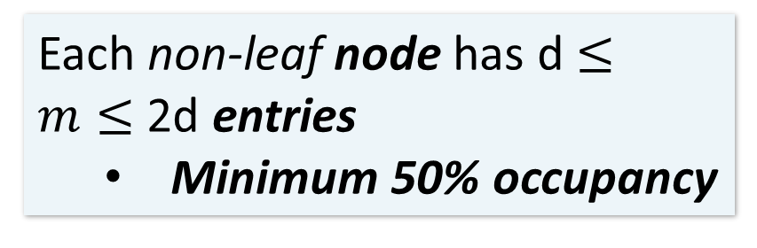
B+ Tree
B+ Tree basics
Parameter d = the order
10 |  | 20 |  | 30
Each non-leaf node has d $≤m≤$ 2d entries
Minimum 50% occupancy
10 |  | 20 |  | 30
Root node has 1 $≤m≤$ 2d entries
k < 10
20 $≤k$< 30
The n entries in a node define n+1 ranges
30 $≤k$
10 $≤k$< 20
Notes:
Minimum 50% occupancy
Công suất tối thiểu 50%
n ; search key
d = n+ 1/2 (n = 2d)

Slide 20
B+ Tree
B+ Tree basics
Leaf nodes also have between d and 2d entries, and are different in that:
Non-leaf or internal node
10 |  | 20 |  | 30
Their entry slots contain pointers to data records
Leaf nodes
22 |  | 25 |  | 28 |  | 29
32 |  | 34 |  | 37 |  | 38
15
21
22
27
28
30
33
35
37

Slide 21
B+ Tree Basics
B+ Tree
Leaf nodes also have between d and 2d entries, and are different in that:
Non-leaf or internal node
10 |  | 20 |  | 30
Their entry slots contain pointers to data records
Leaf nodes
12 |  | 17
22 |  | 25 |  | 28 |  | 29
32 |  | 34 |  | 37 |  | 38
They contain a pointer to the next leaf node as well, for faster sequential traversal
11
15
21
22
27
28
30
33
35
37
Notes:
86/5000
Chúng cũng chứa một con trỏ tới nút lá tiếp theo, để truyền tải tuần tự nhanh hơn

Slide 22
B+ Tree Basics
B+ Tree
Non-leaf or internal node
Note that the pointers at the leaf level will be to the actual data records (rows).
We might truncate these for simpler display (as before)…
10 |  | 20 |  | 30
Leaf nodes
12 |  | 17
22 |  | 25 |  | 28 |  | 29
32 |  | 34 |  | 37 |  | 38
Name: Jake
Age: 15
Name: Bess
Age: 22
Name: Sally
Age: 28
Name: Sue
Age: 33
Name: Jess
Age: 35
Name: Alf
Age: 37
Name: Joe
Age: 11
Name: John
Age: 21
Name: Bob
Age: 27
Name: Sal
Age: 30

Slide 23
B+ Tree Page Format
B+ Tree
index entries
P
K
P
K
P
P
K
P
Non-leaf
Page
1
1
2
2
3
m
m
m+1
Pointer to a page with
Values < K₁
Pointer to a page
with values s.t.
K₁≤ Values < K₂
Pointer to a page
with values s.t.,
K₂≤ Values < K₃
Pointer to a page with values ≥K_{m}
data entries
P
R
K
R
K
R
K
P
0
1
1
2
2
n
n
n+1
Leaf Page
Prev
Page
Pointer
Next
Page
Pointer
record 1
record 2
record n
Notes:
Page: block
Each leaf index node has a single pointer to the next leaf index node to make a scan of the data rows possible without going through the index-level nodes

Slide 24
B+ Trees: Operations, Design & Cost
B+ Tree
B+ tree supports the following operations:
equality search
range search
insert
delete
Notes:
FOR

Slide 25
Searching a B+ Tree
B+ Tree
For exact key values:
Start at the root
Proceed down, to the leaf
For range queries:
As above
Then sequential traversal
SELECT name
FROM people
WHERE age = 25
SELECT name
FROM people
WHERE 20 <= age
AND age <= 30
Notes:
FOR

Slide 26
B+ Tree: Search
B+ Tree
start from root
examine index entries in non-leaf nodes to find the correct child
traverse down the tree until a leaf node is reached
non-leaf nodes can be searched using a binary or a linear search
Notes:
FOR

Slide 27
B+ Tree Search
B+ Tree
K = 30?
30 < 80
80
30 in [20,60)
20 |  | 60
100 |  | 120 |  | 140
30 in [30,40)
10 |  | 15 |  | 18
20 |  | 30 |  | 40 |  | 50
60 |  | 65
80 |  | 85 |  | 90
To the data!
10
12
15
20
28
30
40
60
63
80
84
89
Not all nodes pictured

Slide 28
B+ Tree Range Search Animation
B+ Tree
K in [30,85]?
30 < 80
80
30 in [20,60)
20 |  | 60
100 |  | 120 |  | 140
30 in [30,40)
10 |  | 15 |  | 18
20 |  | 30 |  | 40 |  | 50
60 |  | 65
80 |  | 85 |  | 90
To the data!
10
12
15
20
28
30
40
59
63
80
84
89

Slide 29
B+ Tree: Insert
B+ Tree
Find correct leaf L.
Put data entry onto L.
If L has enough space, done!
Else, must split L (into L and a new node L2)
Redistribute entries evenly, copy up middle key.
Insert index entry pointing to L2 into parent of L.
This can happen recursively
To split non-leaf node, redistribute entries evenly, but pushing up the middle key. (Contrast with leaf splits.)
Splits “grow” tree; root split increases height.
Tree growth: gets wider or one level taller at top.
Notes:
Nếu còn trống –còn chỗ ->chèn bình thường
Điều này có thể xảy ra đệ quy
phân chia nút không phải lá, phân phối lại các mục đồng đều, nhưng đẩy key giữa lên
Chia tách phát triển cây ; làm tăng chiều cao.

Slide 30
B+ Tree
Inserting 8* into B+ Tree
Root
13
17
24
30
2*
3*
5*
7*
14*
16*
19*
20*
22*
24*
27*
29*
33*
34*
38*
39*
Entry to be inserted in parent node Copied up (and continues to appear in the leaf)
5
2*
3*
5*
7*
8*
Notes:
12

Slide 31
B+ Tree
Inserting 8* into B+ Tree
Insert in parent node.
Pushed up (and only appears once in the index)
17
5
13
24
30
Minimum occupancy is guaranteed in both leaf and index page splits
Notes:
12

Slide 32
B+ Tree
Inserting 8* into B+ Tree
Root
17
5
13
24
30
2*
3*
5*
7*
8*
14*
16*
19*
20*
22*
24*
27*
29*
33*
34*
38*
39*
Root was split: height increases by 1
Could avoid split by re-distributing entries with a sibling
Sibling: immediately to left or right, and same parent
Notes:
13

Slide 33
B+ Tree
Inserting 8* into B+ Tree
Root
13
17
24
30
8
2*
3*
5*
7*
14*
16*
19*
20*
22*
24*
27*
29*
33*
34*
38*
39*
8*
14*
16*
Re-distributing entries with a sibling
Improves page occupancy
Usually not used for non-leaf node splits. Why?
Increases I/O, especially if we check both siblings
Better if split propagates up the tree (rare)
Use only for leaf level entries as we have to set pointers
Notes:
13
Phân phối lại các entries với họ hang gần (kế bên)
Cải thiện chiếm dụng trang Thường không được sử dụng để phân chia nút không lá. Tại sao? Tăng I / O, đặc biệt nếu kiểm tra cả hai anh chị em siblings Tốt hơn nếu phân chia lan truyền lên cây (hiếm) Chỉ sử dụng cho các mục cấp độ lá vì chúng ta phải đặt con trỏ

Slide 34
Fast Insertions & Self-Balancing
B+ Tree
The B+ Tree insertion algorithm has several attractive qualities:
~ Same cost as exact search
Self-balancing: B+ Tree remains balanced (with respect to height) even after insert
B+ Trees also (relatively) fast for single insertions!
However, can become bottleneck if many insertions (if fill-factor slack is used up…)
Notes:
Thuật toán chèn B + Tree có một số phẩm chất hấp dẫn: ~ Chi phí tương tự như tìm kiếm chính xác Tự cân bằng: Cây B + vẫn cân bằng (đối với chiều cao) ngay cả sau khi chèn

Slide 35
B+ Tree
B+ Tree: Deleting a data entry
Start at root, find leaf L where entry belongs.
Remove the entry.
If L is at least half-full, done!
If L has only d-1 entries,
Try to re-distribute, borrowing from sibling (adjacent node with same parent as L).
If re-distribution fails, merge L and sibling.
If merge occurred, must delete entry (pointing to L or sibling) from parent of L.
Merge could propagate to root, decreasing height.
Notes:
14
Nếu merge xảy ra, phải xóa mục nhập (trỏ đến L hoặc sibling) từ nút cha của L.
có thể lan truyền đến nút gốc, giảm chiều cao.

Slide 36
B+ Tree
Deleting 22* and 20*
Root
17
5
13
24
30
27
2*
3*
5*
7*
8*
14*
16*
19*
20*
22*
24*
27*
29*
33*
34*
38*
39*
24*
27*
29*
Deleting 22* is easy.
Deleting 20* is done with re-distribution. Notice how the middle key is copied up.
Notes:
15

Slide 37
B+ Tree
And then deleting 24*
Must merge.
In the non-leaf node, toss the index entry with key value = 27
Can this
merge?
30
19*
27*
29*
33*
34*
38*
39*
Root
Pull down of the index entry
5
13
17
30
2*
3*
5*
7*
8*
14*
16*
19*
27*
29*
33*
34*
38*
39*
Notes:
16

Slide 38
B+ Tree
Non-leaf Re-distribution
Tree during deletion of 24*.
Can re-distribute entry from left child of root to right child.
Root
22
5
13
17
20
30
2*
3*
5*
7*
8*
14*
16*
17*
18*
20*
21*
22*
27*
29*
33*
34*
38*
39*
Notes:
17
Have considered redistribution of leaf pages and merging of leaf and non-leaf pages

Slide 39
B+ Tree
After Re-distribution
Rotate through the parent node
It suffices to re-distribute index entry with key 20; For illustration 17 also re-distributed
Root
17
5
13
20
22
30
2*
3*
5*
7*
8*
14*
16*
17*
18*
20*
21*
22*
27*
29*
33*
34*
38*
39*
Notes:
18

Slide 40
B+ Tree
B+ Tree deletion
Try redistribution with all siblings first, then merge. Why?
Good chance that redistribution is possible (large fanout!)
Only need to propagate changes to parent node
Files typically grow not shrink!
Notes:
Hãy thử phân phối lại với tất cả anh chị em trước, sau đó hợp nhất. Tại sao?
Cơ hội tốt để phân phối lại là có thể (fanout lớn!)
Chỉ cần truyền các thay đổi đến nút cha
Tập tin thường phát triển không co lại!

Slide 41
B+ Tree
Duplicates
Duplicate Keys: many data entries with the same key value
Solution 1:
All entries with a given key value reside on a single page
Use overflow pages!
Solution 2:
Allow duplicate key values in data entries
Modify search
Use RID to get a unique (composite) key!
Use list of rids instead of a single rid in the leaf level
Single data entry could still span multiple pages

Slide 42
B+ Tree Design
B+ Tree
How large is d?
Example:
Key size = 4 bytes
Pointer size = 8 bytes
Block size = 4096 bytes
We want each node to fit on a single block/page
2d x 4 + (2d+1) x 8 <= 4096 → d <= 170
NB: Oracle allows 64K = 2^16 byte blocks
→ d <= 2730
Notes:
d: search key

Slide 43
B+ Tree: High Fanout = Smaller & Lower IO
B+ Tree
The fanout is defined as the number of pointers to child nodes coming out of a node
Note that fanout is dynamic- we’ll often assume it’s constant!
As compared to e.g. binary search trees, B+ Trees have high fanout (between d+1 and 2d+1)
This means that the depth of the tree is small → getting to any element requires very few IO operations!
Also can often store most or all of the B+ Tree in main memory!
A TiB = 2⁴⁰ Bytes. What is the height of a B+ Tree (with fill-factor = 1) that indexes it (with 64K pages)?
(2*2730 + 1)^{h} = 2⁴⁰ → h = 4
The known universe contains ~10⁸⁰ particles… what is the height of a B+ Tree that indexes these?
Notes:
Note that fanout is dynamic- we’ll often assume it’s constant just to come up with approximate eqns!

Slide 44
B+ Trees in Practice
B+ Tree
Typical order: d=100. Typical fill-factor: 67%.
average fanout = 133
Typical capacities:
Height 4: 133⁴ = 312,900,700 records
Height 3: 133³ = 2,352,637 records
Top levels of tree sit in the buffer pool:
Level 1 = 1 page = 8 Kbytes
Level 2 = 133 pages = 1 Mbyte
Level 3 = 17,689 pages = 133 MBytes
Fill-factor is the percent of available slots in the B+ Tree that are filled; is usually < 1 to leave slack for (quicker) insertions
Typically, only pay for one IO!

Slide 45
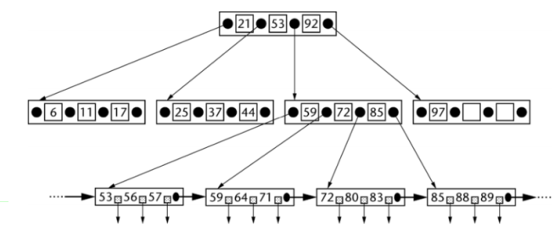
Cost: Number of Block accesses : Read
B+ Tree
B+ tree with h height : h > log n/log p
Read a single row in a table (using a B+tree) = h + 1 block accesses.
Notes:
number of rows in the table (n).
p: pointer & p key value

Slide 46
Cost: Number of Block accesses : Update
B+ Tree
B+ tree with h height
Update cost for a single row (B+tree) = search cost + rewrite data block = (h + 1) + 1 = h + 2 block accesses
Notes:
number of rows in the table (n).
p: pointer & p key value

Slide 47
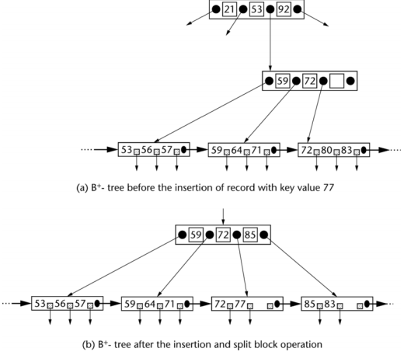
Cost: Number of Block accesses : Insert
B+ Tree
Insert cost for a single row (B+tree) = search cost + rewrite data block + rewrite index block = (h + 1) + 1 + 1 = h + 3 block accesses,
Notes:
number of rows in the table (n).
p: pointer & p key value

Slide 48
Cost: Number of Block accesses : Delete
B+ Tree
Deletions may result in emptying a data block or index node, which necessitates the consolidation of two nodes into one.
This may require a rewrite of the leaf index node to reset its pointers. The empty data node can be either left alone or rewritten with nulls, depending on the implementation
Delete cost for a single row (B+tree) = search cost + rewrite data block + rewrite index block = (h + 1) + 1 + 1 = h + 3 block accesses
Notes:
number of rows in the table (n).
p: pointer & p key value

Slide 49
Clustered Indexes
B+ Tree
An index is clustered if the underlying data is ordered in the same way as the index’s data entries.
Notes:
11
Một chỉ mục được nhóm nếu dữ liệu cơ bản được sắp xếp theo cùng cách với các mục nhập dữ liệu của chỉ mục.

Slide 50
Clustered vs. Unclustered Index
B+ Tree
30
30
Index Entries
22 |  | 25 |  | 28 |  | 29
32 |  | 34 |  | 37 |  | 38
22 |  | 25 |  | 28 |  | 29
32 |  | 34 |  | 37 |  | 38
19
22
27
28
30
33
35
37
19
33
27
22
37
28
35
30
Data Records
Clustered
Unclustered

Slide 51
Clustered vs. Unclustered Index
B+ Tree
Recall that for a disk with block access, sequential IO is much faster than random IO
For exact search, no difference between clustered / unclustered
For range search over R values: difference between 1 random IO + R sequential IO, and R random IO:
A random IO costs ~ 10ms (sequential much much faster)
For R = 100,000 records- difference between ~10ms and ~17min!

Slide 52
Summary
B+ Tree
We create indexes over tables in order to support fast (exact and range) search and insertion over multiple search keys
B+ Trees are one index data structure which support very fast exact and range search & insertion via high fanout
Clustered vs. unclustered makes a big difference for range queries too

Slide 53
B⁺-tree indices are an alternative to indexed sequential files
B+ Tree
Advantage of B⁺-tree index files: automatically reorganizes itself with small, local, changes, in the face of insertions and deletions. Reorganization of entire file is not required to maintain performance.
Advantages of B⁺-trees outweigh disadvantages, and they are used extensively
Disadvantage of indexed-sequential files: performance degrades as file grows, since many overflow blocks get created. Periodic reorganization of entire file is required.
Disadvantage of B⁺-trees: extra insertion and deletion overhead, space overhead.
Notes:
Ưu điểm của tệp chỉ mục B + -tree: tự động tổ chức lại chính nó với các thay đổi nhỏ, cục bộ, khi đối mặt với các phần chèn thêm và xóa. Tổ chức lại toàn bộ tập tin là không cần thiết để duy trì hiệu suất.
Ưu điểm của B + -trees lớn hơn nhược điểm và chúng được sử dụng rộng rãi
Nhược điểm của các tệp tuần tự được lập chỉ mục: hiệu suất giảm khi tệp phát triển, do nhiều khối tràn được tạo. Tổ chức lại định kỳ của toàn bộ tập tin được yêu cầu.
Nhược điểm của B + -trees: thêm chi phí chèn và xóa, chi phí không gian.

Slide 54
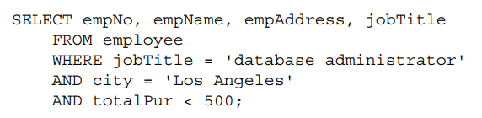
Composite Index
Composite Index Search
Like a single index, a composite index is also a data structure of records sorted on something. But unlike a single index, that something is not a field, but a concatenation of multiple fields.
Composite Index: define indices on multiple columns. This index is called a Multi-column / Composite / Compound index.

Slide 55
How does composite index work?
Composite Index Search
The columns used in composite indices are concatenated together, and those concatenated keys are stored in sorted order using a B+ Tree.
When you perform a search, concatenation of your search keys is matched against those of the composite index
In a nonunique index, the key field is a concatenation of all the attributes you want to set up to access the set of rows desired
Example:
create index NameIndex on Table1(A1,A2,A3) using B+TREE
Notes:
For the nonunique leaf nodes, we also have key-pointer pairs, but the key values are the complete set of all combinations of the composite key that actually occur in existing rows

Slide 56
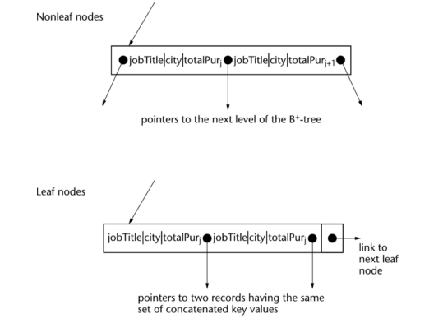
How does composite index work?
Composite Index Search
B+tree search of concatenated keys is much faster than searching for the target rows over
and over for each individual key using multiple simple indexes
Notes:
For the nonunique leaf nodes, we also have key-pointer pairs, but the key values are the complete set of all combinations of the composite key that actually occur in existing rows

Slide 57
Example
Customer rows have attributes for customer name, customer number, street address, city, state, zip code, phone number, e-mail, employer, job title, credit rating, date of last purchase, and total amount of purchases
A table of 10 million rows
Row size is 250 bytes; block size is 5,000 bytes; pointer size, including row offset, is 5 bytes; and composite key for jobTitle, city, and totalPur is 35 bytes. The table of 10 million rows has 500,000 blocks since each block contains 20 rows
SQL. SELECT empNo, empName, empAddress, empPhone, empEmail FROM customer WHERE jobTitle = 'software engineer' AND city = 'Chicago' AND totalPur > 1000
For each AND condition we have the following hit rates Job title (jobTitle) is ‘software engineer’: 84,000 rows. City (city) is ‘Chicago’: 210,000 rows. Total amount of purchases (totalPur) > $1,000: 350,000 rows. Total number of target rows that satisfy all three conditions = 750. Query cost ??

Slide 58
Query cost
If we assume the total of 84,000 + 210,000 + 350,000 = 644,000 pointers fit into blocks holding (5,000 bytes/35 bytes = 142) pointers each
cost of using the three index approach is : = three index search cost + merge pointer cost + final data access cost = (h1 + 1) + (h2 + 1) + (h3 + 1) + 644,000/142 + 750 block accesses = 3 + 4 + 4 + 4,535 + 750 block accesses.
Block access time = 2 ms rotational delay + transfer time of 5,000 bytes/320 MB/sec = 2.02 ms. Query I/O time = 761 × 2.02 ms + (4,535 blocks × 5,000 bytes/block)/320 MB/sec = 1.54 sec + .07 sec = 1.61 seconds.
Notes:
If we assume h1 = 2, h2 = 3, and h3 = 3, then we have
If we assume an individual block access takes 2 ms for the average rotational delay and our high-speed disk scans the block at 320 MB/sec, then the total cost in terms of I/O time is:

Slide 59
Query cost Composite Index Approach
5,000 bytes/block >= p × 5 for pointers + (p – 1) × 35 for index entries => p = 125
h > log n / log p = log 10,000,000/log 125 = 7/2.097 = 3.34, or h = 4
Number of blocks needed to hold 750 target row pointers = 750/(5,000 bytes/block/35 bytes/pointer) = 750/142 = 5.28 blocks => 6 blocks.
Query cost = composite index search + pointer search for target records + final data access cost = h + 6 + 750 = 4 + 6 + 750 block accesses. Query I/O time = 754 × 2.02 ms + (6 blocks × 5,000 bytes/block)/320 MB/sec = 1.52 seconds.

Slide 60
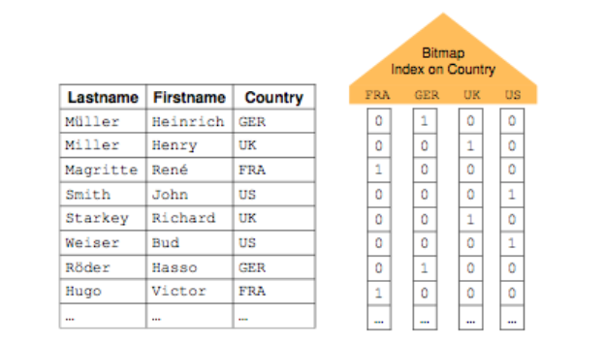
Bitmap Indexing in DBMS
Bitmap Indexing
Bitmap Indexing is a special type of database indexing that uses bitmaps. This technique is used for huge databases, when column is of low cardinality and these columns are most frequently used in the query.

Slide 61
Storing the Bitmap index
Bitmap Indexing
One bitmap for each value, and one for Nulls
Need to store each bitmap
Simple method: 1 file for each bitmap
Can compress the bitmap!
Index size?
#tuples * (cardinality of the domain + 1)
bits
When is a bitmap index more space efficient than a B+-tree?
#distinct values < data entry size in the B+-tree

Slide 62
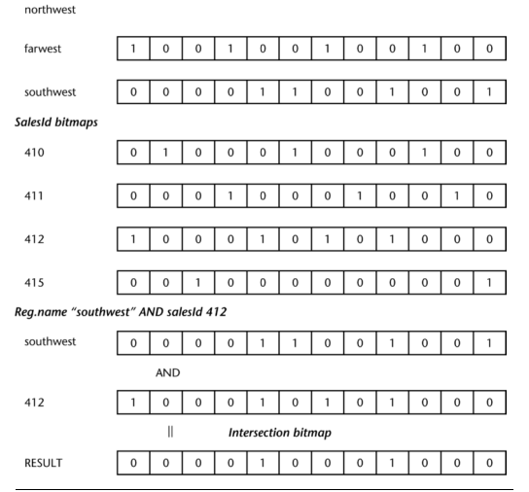
Advantages Disadvantages of Bitmap
Bitmap Indexing
Advantages
Efficiency in terms of insertion deletion and updation
Faster retrieval of records
Disadvantages
Only suitable for large tables
Bitmap Indexing is time consuming
Notes:
Ưu điểm
Hiệu quả về mặt xóa chèn và cập nhật
Truy xuất hồ sơ nhanh hơn
Nhược điểm
Chỉ thích hợp cho table lớn
Lập chỉ mục bitmap tốn thời gian

Slide 63
How to choose indexes
…
Attributes in WHERE clause are candidates for index keys
exact match condition suggests hash index
indexes also speed up joins (later in class)
range query suggests tree index (B+ tree)
Multi-attribute search keys should be considered when a WHERE clause contains several conditions
order of attributes is important for range queries
such indexes can enable index-only strategies for queries
Notes:
Lời khuyên: không nên sử dụng chỉ mục
- trên các mối quan hệ nhỏ, - trên các thuộc tính được sửa đổi thường xuyên, - trên các thuộc tính không chọn lọc (các truy vấn trả về ≥ 15% dữ liệu) - trên các thuộc tính có chuỗi giá trị dài
Xác định chỉ mục trên khóa chính và khóa ngoài
Xem xét định nghĩa của các chỉ mục trên các thuộc tính được sử dụng trên các truy vấn yêu cầu sắp xếp: ORDER BY, GROUP BY, DISTINCT, Đặt thao tác
Các chỉ mục không nên được sử dụng trong các bảng nhỏ. - Bảng mà thường xuyên có các tác vụ update, insert. - Các chỉ mục không nên được sử dụng trên các cột mà chứa một số lượng lớn giá trị NULL. - Không nên dùng chỉ mục trên các cột mà thường xuyên update

Slide 64
How to choose indexes
…
Composite search keys: search on a combination of fields (e.g. <date, price>)
equality query: every field value is equal to a constant value
date=“02-20-2015” and price =75
range query: some field value is not a constant
date=“02-20-2015”
date=“02-20-2015” and price > 40
Notes:
Lời khuyên: không nên sử dụng chỉ mục
- trên các mối quan hệ nhỏ, - trên các thuộc tính được sửa đổi thường xuyên, - trên các thuộc tính không chọn lọc (các truy vấn trả về ≥ 15% dữ liệu) - trên các thuộc tính có chuỗi giá trị dài
Xác định chỉ mục trên khóa chính và khóa ngoài
Xem xét định nghĩa của các chỉ mục trên các thuộc tính được sử dụng trên các truy vấn yêu cầu sắp xếp: ORDER BY, GROUP BY, DISTINCT, Đặt thao tác
Các chỉ mục không nên được sử dụng trong các bảng nhỏ. - Bảng mà thường xuyên có các tác vụ update, insert. - Các chỉ mục không nên được sử dụng trên các cột mà chứa một số lượng lớn giá trị NULL. - Không nên dùng chỉ mục trên các cột mà thường xuyên update

Slide 65
How to choose indexes
…
Tips: don’t use indexes
- on small relations, - on frequently modified attributes, - on non selective attributes (queries which returns ≥ 15% of data) - on attributes with values long string
Define indexes on primary and foreign keys
Consider the definition of indexes on attributes used on queries which requires sorting: ORDER BY, GROUP BY, DISTINCT, Set operations
Notes:
Lời khuyên: không nên sử dụng chỉ mục
- trên các mối quan hệ nhỏ, - trên các thuộc tính được sửa đổi thường xuyên, - trên các thuộc tính không chọn lọc (các truy vấn trả về ≥ 15% dữ liệu) - trên các thuộc tính có chuỗi giá trị dài
Xác định chỉ mục trên khóa chính và khóa ngoài
Xem xét định nghĩa của các chỉ mục trên các thuộc tính được sử dụng trên các truy vấn yêu cầu sắp xếp: ORDER BY, GROUP BY, DISTINCT, Đặt thao tác
Các chỉ mục không nên được sử dụng trong các bảng nhỏ. - Bảng mà thường xuyên có các tác vụ update, insert. - Các chỉ mục không nên được sử dụng trên các cột mà chứa một số lượng lớn giá trị NULL. - Không nên dùng chỉ mục trên các cột mà thường xuyên update

Slide 66
Selecting materialized view
Simple View Materialization
Exploiting commonality
Exploiting Grouping and Generalization
Resource Considerations
Tips and Insights for Database Professionals

Slide 67
Simple View Materialization
A materialized view (MV) is a database object that stores the result of a specific query.
There are two ways that materialized views can be accessed.
The first is the brute force method where the SQL is written to explicitly access the view.
The second is for the decision to be made by the query compiler during query optimization.
Effectively a materialized view caches calculations, permitting the reuse of the results, which leads to faster query responses and disk I/O.

Slide 68
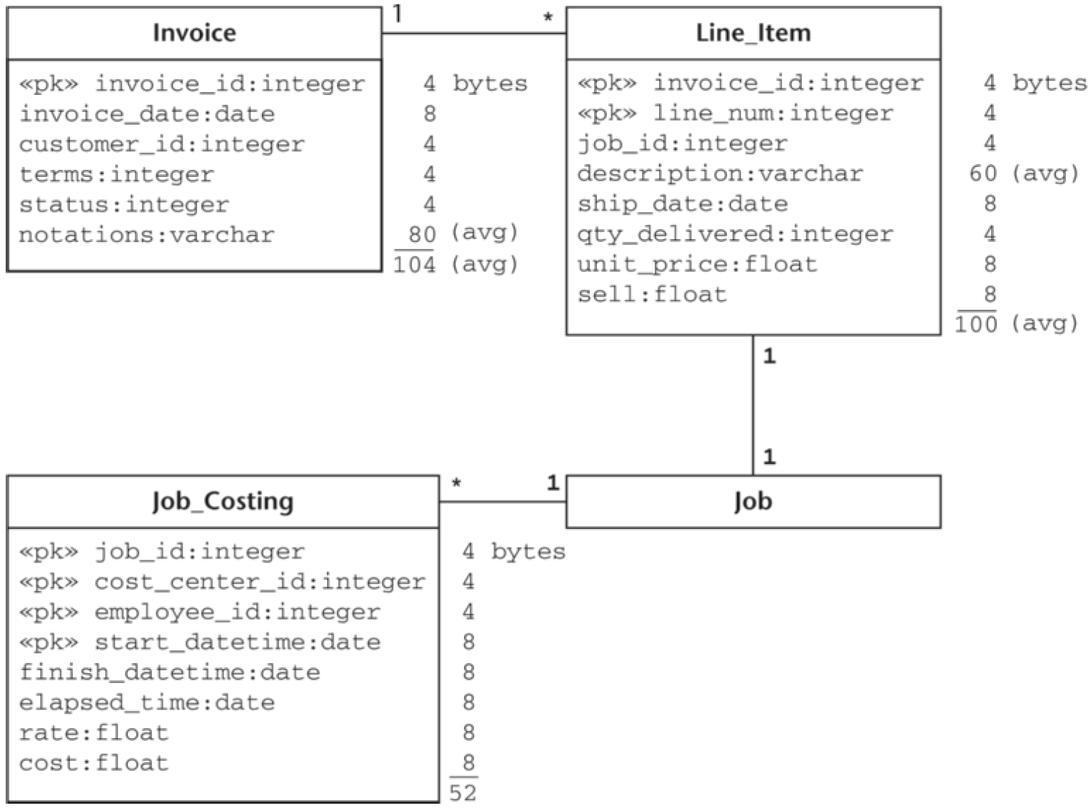
Simple View Materialization
Average jobs/day = 10,000.
Average invoices/day = 5,000.
Average Job_Costing/day = 50.
Days on record = 200.
Customers = 5,000.
The row in all tables are clustered in primary key order.
All tables can be sorted in memory.
IBM U320 146 GB hard drive:
I/O time (4KB block in a dedicated disk) = 2.0 ms.
I/O time (64KB buffer in a dedicated disk) = 2.2 ms.
I/O time (4KB block in a shared disk) = 5.6 ms.
I/O time (64KB buffer in a shared disk) = 5.8 ms.
The application requires the cost, sell and profit for each job.
(10 query/day)

Slide 69
Simple View Materialization
SELECT c.job_id,
sum(c.cost) AS cost,
sum(li.sell) AS sell,
sum(li.sell) - sum(c.cost) AS profit
FROM Job_Costing AS c, Line_Item AS li
WHERE c.job_id = li.job_id
GROUP BY c.job_id;
Query I/O time:
Join cost (shared disk)
= scan time (Line_Item and Job_Costing tables using 64 KB prefetch buffers)
Average jobs/day = 10,000.
Average invoices/day = 5,000.
Average Job_Costing/day = 50.
Days on record = 200.
Customers = 5,000.

Slide 70
Simple View Materialization
The Line_Items calculations are:
Average rows per prefetch buffer
= floor((65,536 bytes/ buffer)/(100 bytes/row))
= 655.
Number of buffers
= ceiling((10,000*200) rows/(655 rows/buffer))
= 3,054.
The Job_Costing calculations are:
Average rows per prefetch buffer
= floor((65,536 bytes/ buffer)/(52 bytes/row))
= 1,260.
Number of buffers
= ceiling((50*10,000*200) rows/(1,260 rows/buffer))
= 79,366.
Query I/O time:
Join cost (shared disk)
= scan time (Line_Item and Job_Costing tables using 64 KB prefetch buffers)
= (3,054 + 79,366 buffers) * 5.8 ms
= 82,420 * 5.8 ms
= 478 seconds ≈ 8 minutes
Average jobs/day = 10,000.
Average invoices/day = 5,000.
Average Job_Costing/day = 50.
Days on record = 200.
Customers = 5,000.

Slide 71
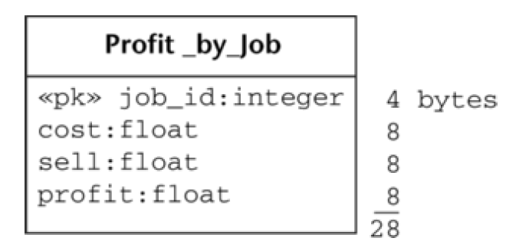
Simple View Materialization
Query I/O time:
Join cost (dedicated disk)
= 82,420 * 2.2 ms
= 181 seconds ≈ 3 minutes
The Profit_by_Job calculations are:
Average rows per prefetch buffer
= floor((65,536 bytes/ buffer)/(28 bytes/row))
= 2,340.
Number of buffers
= ceiling((10,000*200) rows/(2,340 rows/buffer))
= 855.
Write cost (dedicated disk)
= 855*2.2 ms ≈ 2 seconds.
Profit_by_Job creation cost
= join cost + write cost
= 181 + 2 = 183 seconds.
Query I/O time (table scan, shared disk)
= 855*5.8 ms ≈ 5 seconds
Average jobs/day = 10,000.
Average invoices/day = 5,000.
Average Job_Costing/day = 50.
Days on record = 200.
Customers = 5,000.

Slide 72
Simple View Materialization
Disk I/O time before Profit_by_Job:
= query frequency * I/O time per query
= (10 queries/day) * (478 sec/query)
= 4,780 seconds (or about 1 hour, 20 min)
Disk I/O time with Profit_by_Job:
= creation cost + query frequency * I/O time per query
= 183 sec createion cost + (10 queries/day) * (5 sec/query)
= 233 seconds
Average jobs/day = 10,000.
Average invoices/day = 5,000.
Average Job_Costing/day = 50.
Days on record = 200.
Customers = 5,000.
The materialized view may be much smaller than the base tables, leading to large gains in disk I/O performance per query.
Frequent queries multiply the gain.

Slide 73
Exploiting Commonality
Tracking profitability by invoice date (5 query/day).
Tracking profitability by customer (3 query/day).
Average jobs/day = 10,000.
Average invoices/day = 5,000.
Average Job_Costing/day = 50.
Days on record = 200.
Customers = 5,000.

Slide 74
Tracking profitability by invoice date
SELECT i.invoice_date, sum(c.cost) AS cost, sum(li.sell)
AS sell,
sum(li.sell) - sum(c.cost) AS profit
FROM Invoice AS i, Job_Costing AS c, Line_Item AS li
WHERE i.invoice_id = li.invoice_id
AND c.job_id = li.job_id
GROUP BY i.invoice_date;
Average jobs/day = 10,000.
Average invoices/day = 5,000.
Average Job_Costing/day = 50.
Days on record = 200.
Customers = 5,000.

Slide 75
Tracking profitability by invoice date
The Invoice calculations are:
Average rows per prefetch buffer
= floor((65,536 bytes/ buffer)/(104 bytes/row))
= 630.
Number of buffers
= ceiling((5000*200) rows/(630 rows/buffer))
= 1,588.
Query I/O time (shared disk)
= scan Line_Item + scan Invoice + scan Job_Costing
= (3,054 + 1,588 + 79,366 buffers) * 5.8 ms
= 84,008 * 5.8 ms
= 487 seconds.
Average jobs/day = 10,000.
Average invoices/day = 5,000.
Average Job_Costing/day = 50.
Days on record = 200.
Customers = 5,000.

Slide 76
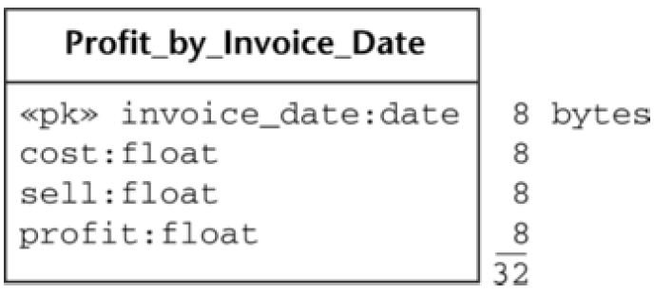
Tracking profitability by invoice date
Query I/O time:
= 84,008 * 2.2 ms
≈ 185 seconds.
The Profit_by_Invoice_Date calculations are:
Average rows per prefetch buffer
= floor((65,536 bytes/ buffer)/(32 bytes/row))
= 2,048.
Number of buffers
= ceiling(200 rows/(2,048 rows/buffer))
= 1.
Write cost (dedicated disk)
= 1 * 2.2 ms = 2.2 ms
Creation cost
= query cost + write cose
= 185 sec + 0.0022 sec ≈ 185 seconds.
Query I/O time (shared disk)
= 1 * 5.8 ms = 5.8 ms.
Average jobs/day = 10,000.
Average invoices/day = 5,000.
Average Job_Costing/day = 50.
Days on record = 200.
Customers = 5,000.

Slide 77
Tracking profitability by invoice date
Disk I/O time before Profit_by_Invoice_Date:
= query frequency * I/O time per query
= (5 queries/day) * (487 sec/query)
= 2,435 seconds (or about 40 min)
Disk I/O time with Profit_by_Invoice_Date:
= creation cost + query frequency * I/O time per query
= 185 sec creation cost + (5 queries/day) * (5.8 ms/query)
≈ 185 seconds
Average jobs/day = 10,000.
Average invoices/day = 5,000.
Average Job_Costing/day = 50.
Days on record = 200.
Customers = 5,000.

Slide 78
Tracking profitability by customer
SELECT i.customer_id,
sum(c.cost) AS cost, sum(li.sell) AS sell,
sum(li.sell) - sum(c.cost) AS profit
FROM Invoice AS i, Job_Costing AS c, Line_Item AS li
WHERE i.invoice_id = li.invoice_id
AND c.job_id = li.job_id
GROUP BY i.customer_id;
Average jobs/day = 10,000.
Average invoices/day = 5,000.
Average Job_Costing/day = 50.
Days on record = 200.
Customers = 5,000.

Slide 79
Tracking profitability by customer
The Invoice calculations are:
Average rows per prefetch buffer
= 630.
Number of buffers
= 1,588.
Query I/O time (shared disk)
= scan Line_Item + scan Invoice + scan Job_Costing
= 84,008 * 5.8 ms
= 487 seconds.
Average jobs/day = 10,000.
Average invoices/day = 5,000.
Average Job_Costing/day = 50.
Days on record = 200.
Customers = 5,000.

Slide 80
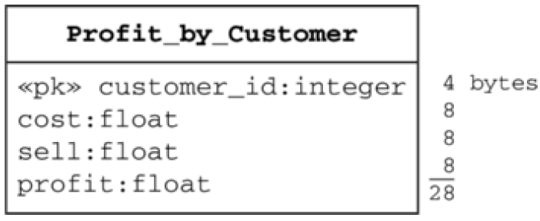
Tracking profitability by customer
Query I/O time:
= 84,008 * 2.2 ms
≈ 185 seconds.
The Profit_by_Customer calculations are:
Average rows per prefetch buffer
= floor((65,536 bytes/ buffer)/(28 bytes/row))
= 2,340.
Number of buffers
= ceiling(5000 rows/(2,340 rows/buffer))
= 3.
Write cost (dedicated disk)
= 3 * 2.2 ms = 6.6 ms
Creation cost
= query cost + write cose
= 185 sec + 0.0066 sec ≈ 185 seconds.
Query I/O time (shared disk)
= 3 * 5.8 ms = 17.4 ms.
Average jobs/day = 10,000.
Average invoices/day = 5,000.
Average Job_Costing/day = 50.
Days on record = 200.
Customers = 5,000.

Slide 81
Tracking profitability by customer
Disk I/O time before Profit_by_Customer:
= query frequency * I/O time per query
= (3 queries/day) * (487 sec/query)
= 1,461 seconds
Disk I/O time with Profit_by_Customer :
= creation cost + query frequency * I/O time per query
= 185 sec creation cost + (3 queries/day) * (0.017 sec/query)
≈ 185 seconds
Average jobs/day = 10,000.
Average invoices/day = 5,000.
Average Job_Costing/day = 50.
Days on record = 200.
Customers = 5,000.

Slide 82
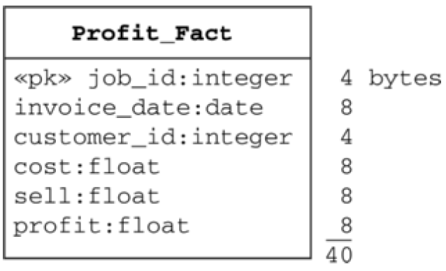
Exploiting Commonality
SELECT c.job_id, i.invoice_date, i.customer_id,
sum(c.cost) AS cost,
sum(li.sell) AS sell,
sum(li.sell) - sum(c.cost) AS profit
FROM Invoice AS i, Job_Costing AS c, Line_Item AS li
WHERE i.invoice_id = li.invoice_id
AND c.job_id = li.job_id
GROUP BY c.job_id, i.invoice_date, i.customer_id;

Slide 83
Exploiting Commonality
Query I/O time:
= 84,008 * 2.2 ms
≈ 185 seconds.
The Profit_Fact calculations are:
Average rows per prefetch buffer
= floor((65,536 bytes/buffer)/(40 bytes/row))
= 1,638.
Number of buffers
= ceiling((10,000*200)rows/(1,638 rows/buffer))
= 1,222.
Write cost (dedicated disk)
= 1,222 * 2.2 ms ≈ 3 seconds.
Creation cost
= query cost + write cose
≈ 185 sec + 3 sec ≈ 188 seconds.
Query I/O time (shared disk)
= 1,222 * 5.8 ms = 7 seconds.
Average jobs/day = 10,000.
Average invoices/day = 5,000.
Average Job_Costing/day = 50.
Days on record = 200.
Customers = 5,000.

Slide 84
Exploiting Commonality
Disk I/O time using base tables:
= (4,780 + 2,435 + 1,461 sec)/day
= 8,676 sec/days.
Disk I/O time using Profit_by_Job, Profit_by_Invoice_Date, Profit_by_Customer:
= (233 + 185 + 185 sec)/day
= 603 sec/day
Disk I/O time using Profit_Fact:
= creation cost + (query frequency* I/O time per query)
= 188 sec creation cost
+ (10 profit by job queries/day)*(7 sec/query)
+ (5 profit by date queries/day)*(7 sec/query)
+ (3 profit by customer queries/day)*(7 sec/query)
≈ 314 sec/day.

Slide 85
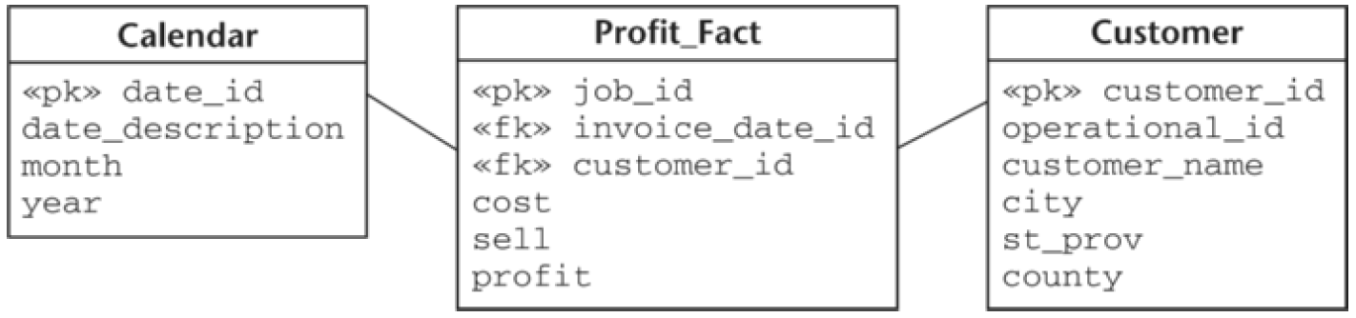
Exploiting Group and Generalization
This is the query to obtain profitability information at the monthly level for 2006:
This is the query to obtain data at the state level by year:
SELECT month, sum(cost), sum(sell), sum(profit)
FROM Calendar AS c, Profit_Fact AS p
WHERE year = 2006
AND c.date_id = p.date_id
GROUP BY month
ORDER BY month;
SELECT country, st_prov, year, sum(cost), sum(sell),
sum(profit)
FROM Calendar AS cal, Profit_Fact AS p, Customer AS cust
WHERE cal.date_id = p.date_id
AND cust.customer_id = p.customer_id
GROUP BY country, st_prov, year
ORDER BY country, st_prov, year;

Slide 86
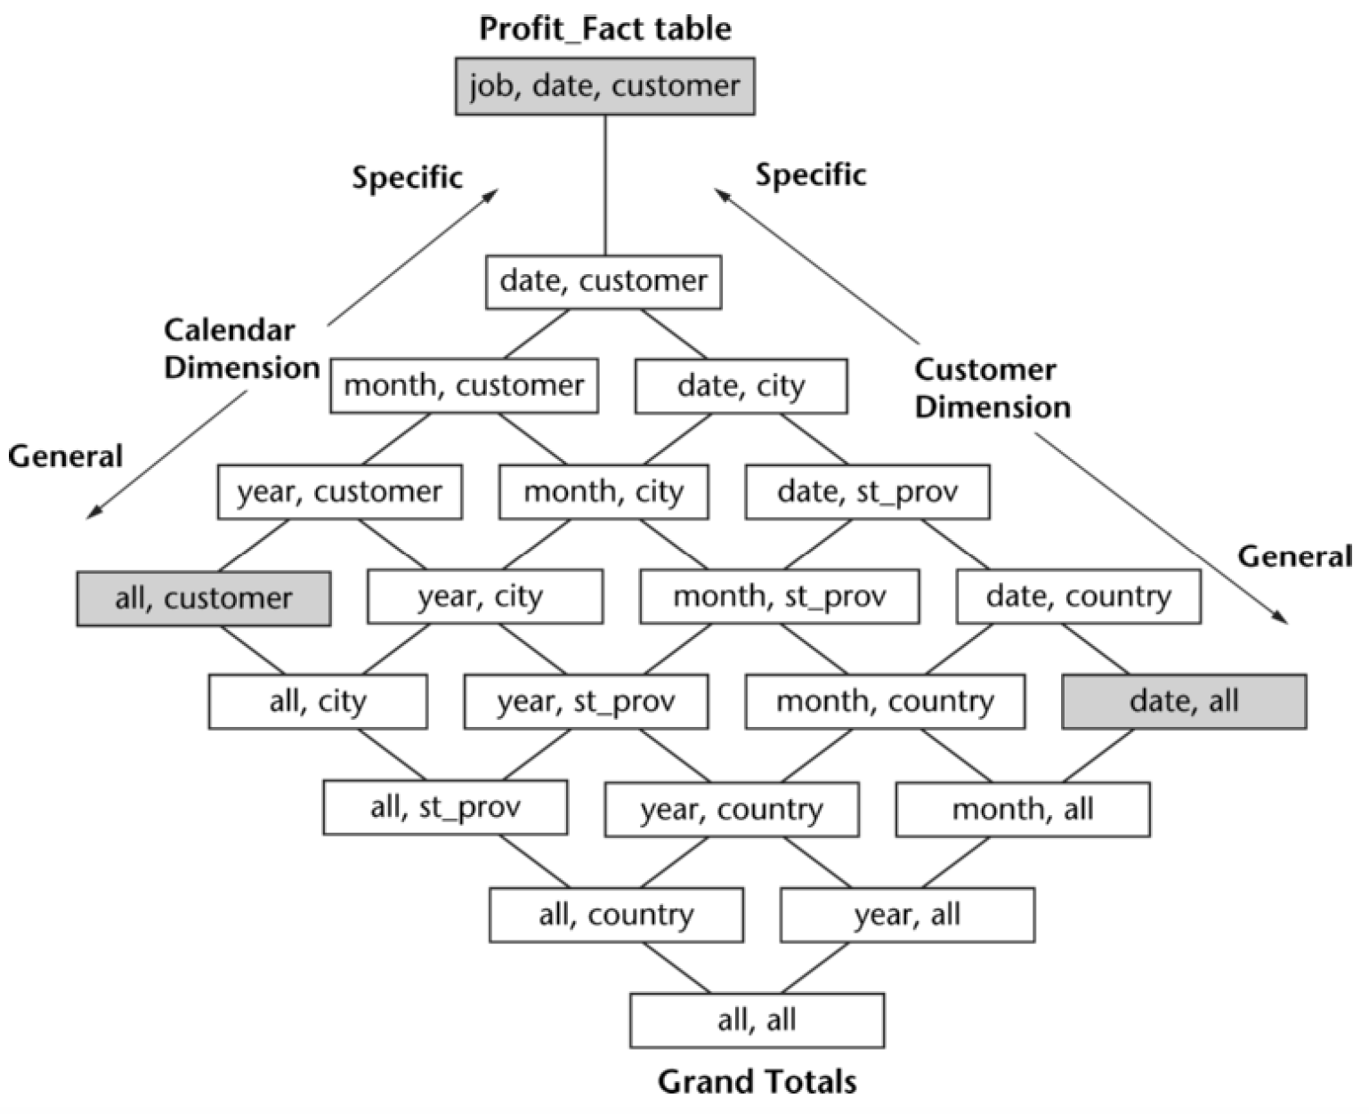
Exploiting Group and Generalization
Product graph in Calendar and Customer dimensions.

Slide 87
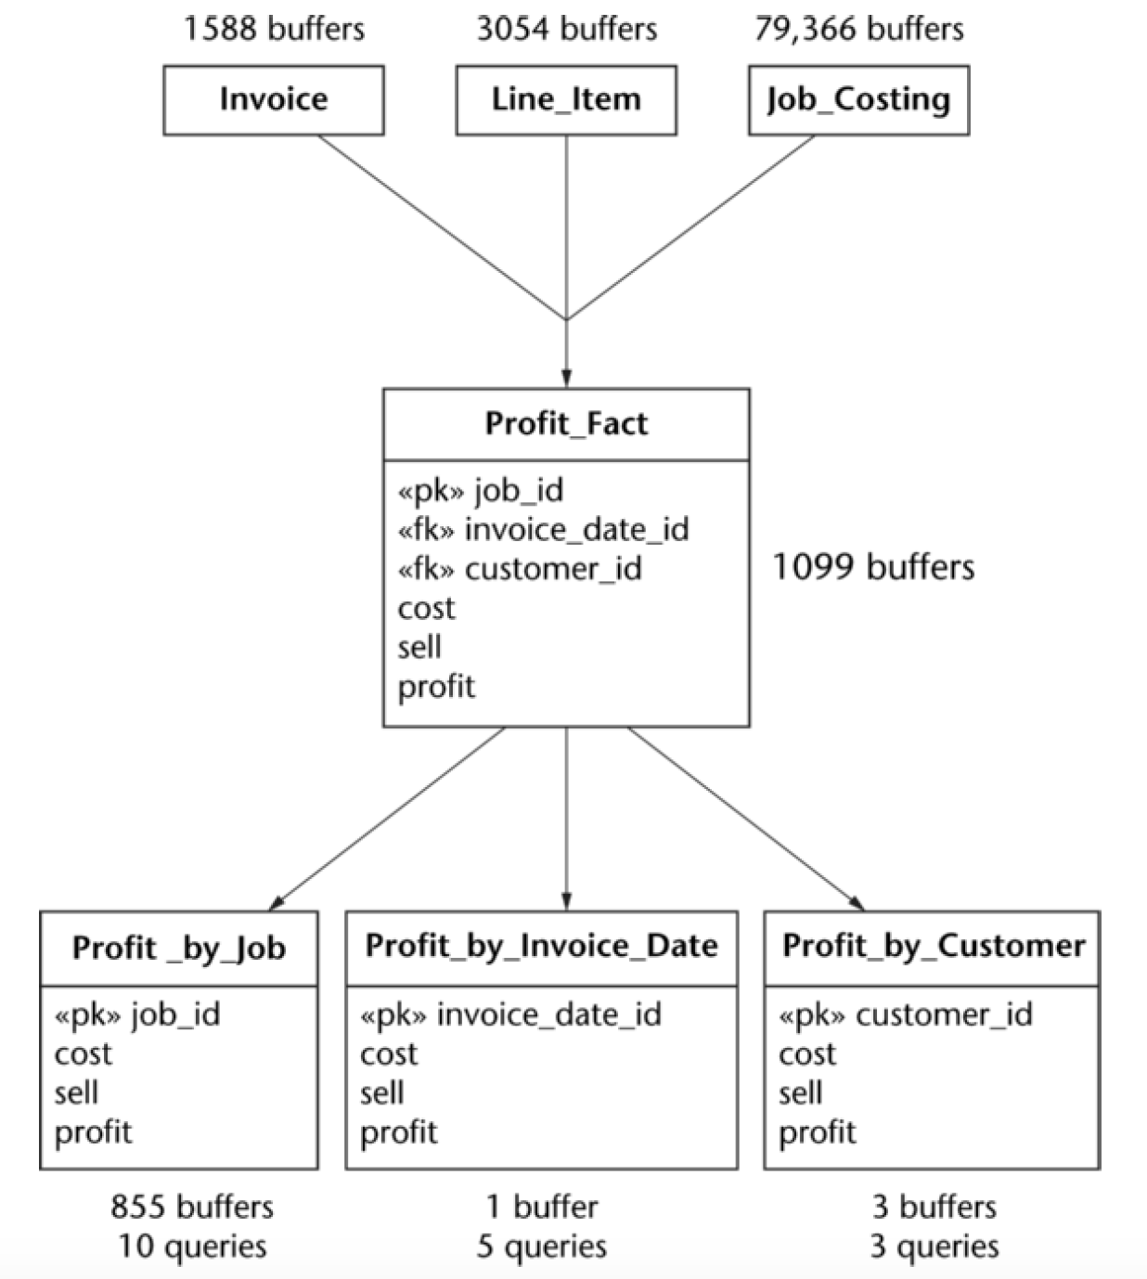
Resource Considerations
The number of materialized views.
The extra disk space required.
The length of the available update windows.
A simplified lattice

Slide 88
Tips and insights for database professionals
Utilizing materialized view can bring marked improvement in both total disk I/O and query response.
Good candidates to consider for materialization are the natural view of frequent queries and also common ancestors of those views.
Star schemas can make a materialized view applicable to a large family of queries, thereby multiplying the gain for the given resources.
Lattice structure diagrams can facilitate the selection of materialized views and also the planning of data update paths through the lattice.

Slide 89
Tips and insights for database professionals
Decide on the update strategy for each materialized view.
Set a limit on the number of views you are willing to design and maintain.
Decide on a limit for the amount of disk space available for materialized views.
Materialized views need indexing too!
Help the query compiler find matching materialized views.
Avoid problematic materialized view designs that make routing hard.

Slide 90




